Slide 1
Underfitting and Overfitting

Slide 2
Bias and Variance
Bias – error caused because the model can not represent the concept
Variance – error caused because the learning algorithm overreacts to small changes (noise) in the training data

Slide 3
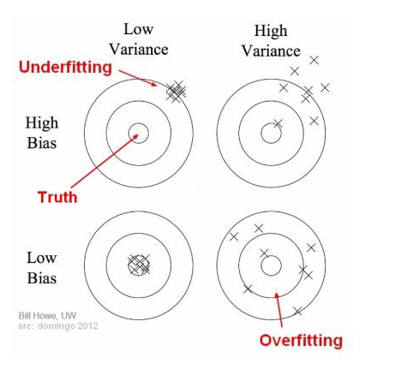
Bias and variance

Slide 4
Underfitting
Definition: Underfitting occurs when a model is too simple to capture the underlying patterns in the data. This typically results in high training and testing errors, as the model fails to generalize or make accurate predictions.
Symptoms:
High bias (errors from erroneous assumptions)
Poor performance on both training and testing sets
Insufficient complexity or inability to capture data trends
Causes:
Model is too simplistic or lacks complexity (e.g., linear model for nonlinear data)
Insufficient training (not enough epochs or iterations)
Too much regularization (penalizing model parameters heavily)
Solutions:
Increase Model Complexity: Use a more complex model (e.g., polynomial regression instead of linear regression).
Increase Features: Add more relevant features to capture more of the data's structure.
Reduce Regularization: Decrease regularization parameters to allow the model to fit the training data better.
Train Longer: Increase the training duration or number of epochs.

Slide 5
Overfitting
Definition: Overfitting happens when a model is excessively complex, capturing noise and anomalies instead of the actual pattern. This results in low training error but high testing error, indicating poor generalization.
Symptoms:
High variance (errors from sensitivity to small fluctuations in data)
Low error on training data, high error on validation/test data
Model performs well on training but poorly on unseen data
Causes:
Model is too complex for the available data (e.g., using a high-degree polynomial)
Excessive training (model "memorizes" data rather than learning patterns)
Lack of sufficient training data to support model complexity
Solutions:
Reduce Model Complexity: Use simpler models or fewer parameters.
Use Regularization: Apply techniques like L2 (Ridge) or L1 (Lasso) regularization to penalize large coefficients.
Cross-Validation: Employ cross-validation techniques (e.g., k-fold) to better understand the model's performance.
Data Augmentation: Increase the diversity of training data by adding variations.
Early Stopping: Stop training when performance on validation data starts to degrade.

Slide 6
Good Fit
Definition: A model with a good fit achieves a balance between bias and variance, accurately capturing the patterns in the training data while generalizing well to new data. This results in low error on both the training and test sets.
Symptoms:
Low bias and variance
Similar, low error rates on training and testing data
Model generalizes well, performing consistently across data
Achieving Good Fit:
Tune Hyperparameters: Adjust parameters carefully to find the optimal balance.
Select the Right Model: Choose a model that is complex enough for the data, but not overly complex.
Use Cross-Validation: Validate the model on different subsets of data to ensure it performs well across varied samples.
Regularize Appropriately: Use regularization methods judiciously to manage complexity without oversimplifying.
Use Sufficient Data: Train with as much data as possible to reduce the chance of overfitting while capturing general patterns.

Slide 7
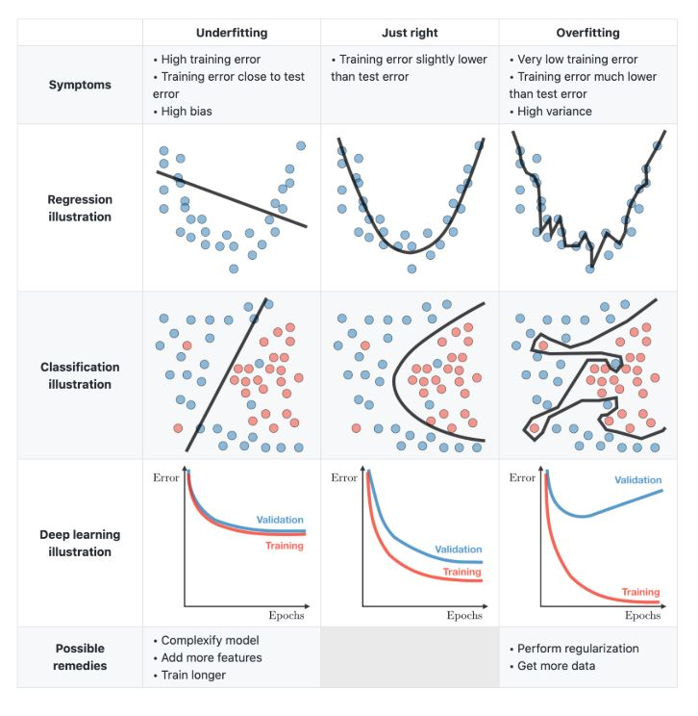
Overview of Overfitting and Underfitting
Error | Underfitting | Good Fit | Overfitting
Training | High | Low | Low
Test | High | Low | High

Slide 8
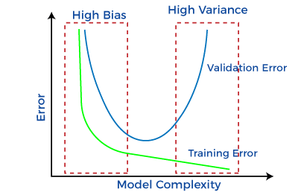
Where should we aim for

